Slide 1
MRA Project – Milestone 2
Contents:
Project Description
Problem Statement
EDA
Dataset Info
Count Plot
Tableau Visualization
Different Trends
KNIME Workflow image
Sample Images of each step on KNIME
Reasons for Association Rule selection
Suggestions and Recommendations

Slide 2
Project Description
The project involves conducting a thorough analysis of Point of Sale (POS) Data for providing recommendations through which a grocery store can increase its revenue by popular combo offers & discounts for customers.

Slide 3
Problem Statement
A Grocery Store shared the transactional data with you. Your job is to identify the most popular combos that can be suggested to the Grocery Store chain after a thorough analysis of the most commonly occurring sets of items in the customer orders. The Store doesn’t have any combo offers. Can you suggest the best combos & offers?

Slide 4
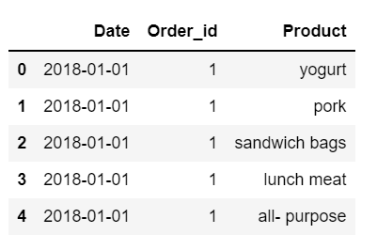
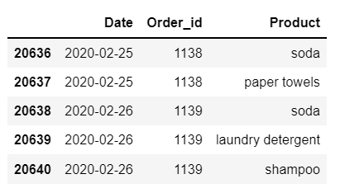
Exploratory Data Analysis(EDA)
Let’s first look at the head and tail of the dataset:
Head Tail

Slide 5
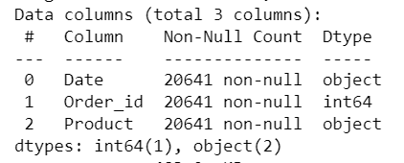
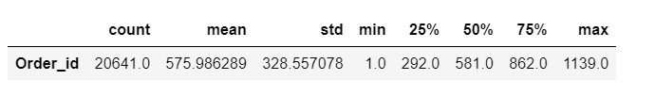
Basic information about the dataset
Shape of the dataset: (20641, 3)
Number of Rows: 20641
Number of Columns: 3
Distinct Columns: Date, Order_id, Product
Data Types: Date(object), Order_id(int64), Product(object)
Five point Summary/Describe:

Slide 6
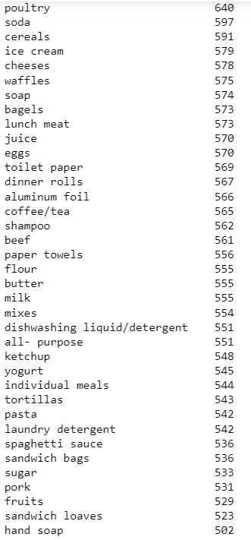
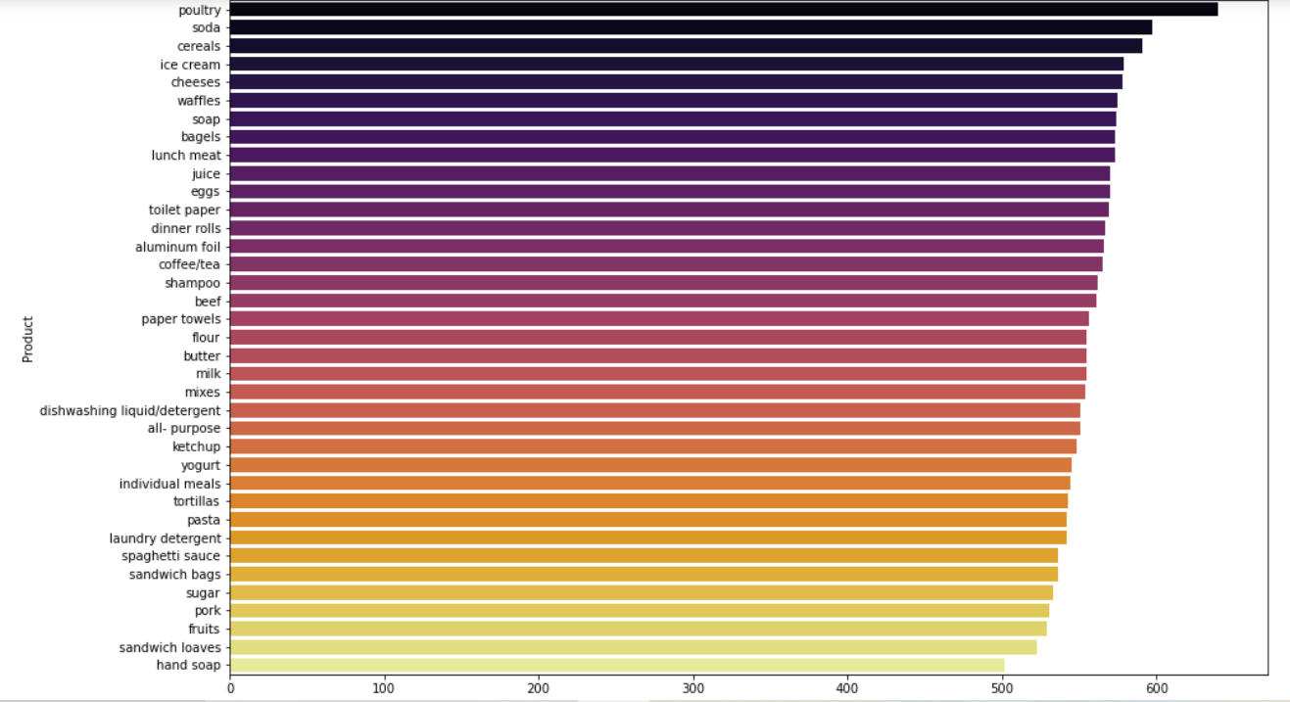
Count of different Products

Slide 7
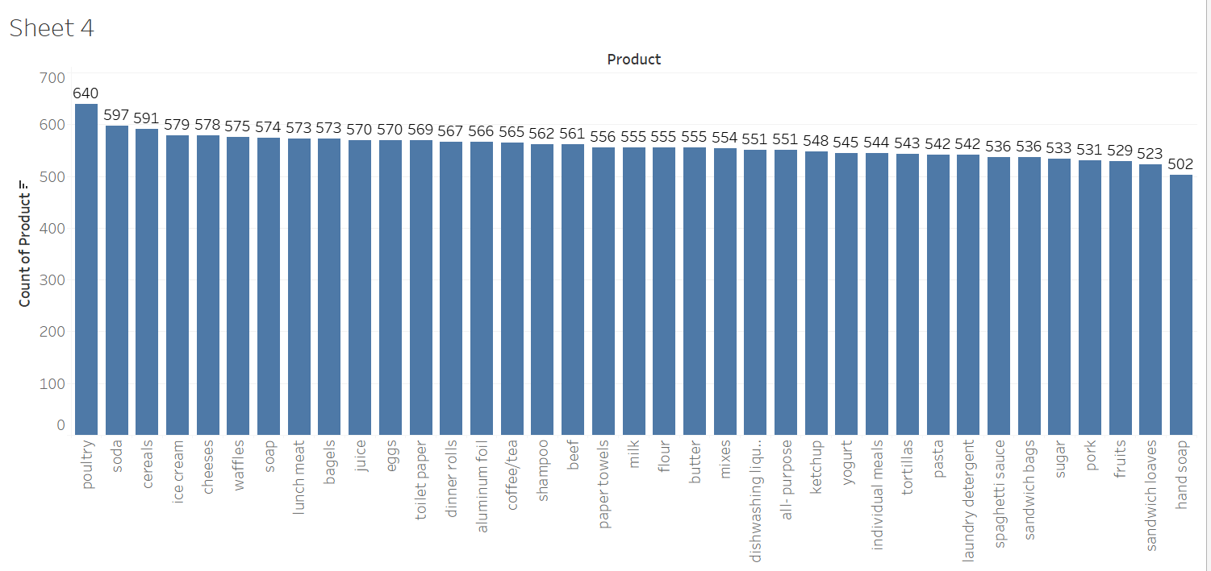
Visualizing the count

Slide 8
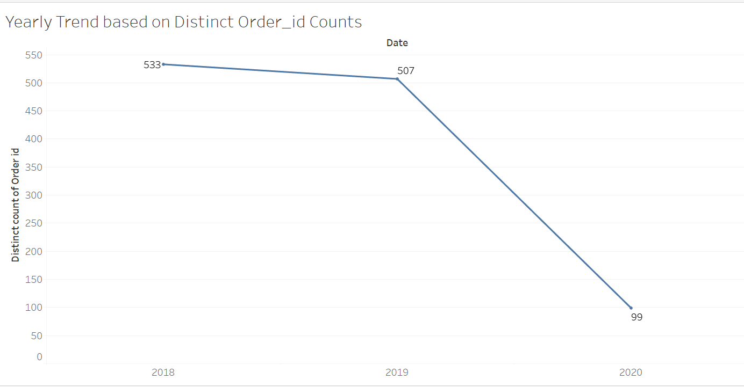
Yearly Trends based on Number of Orders
We have data only till the month of February in 2020.

Slide 9
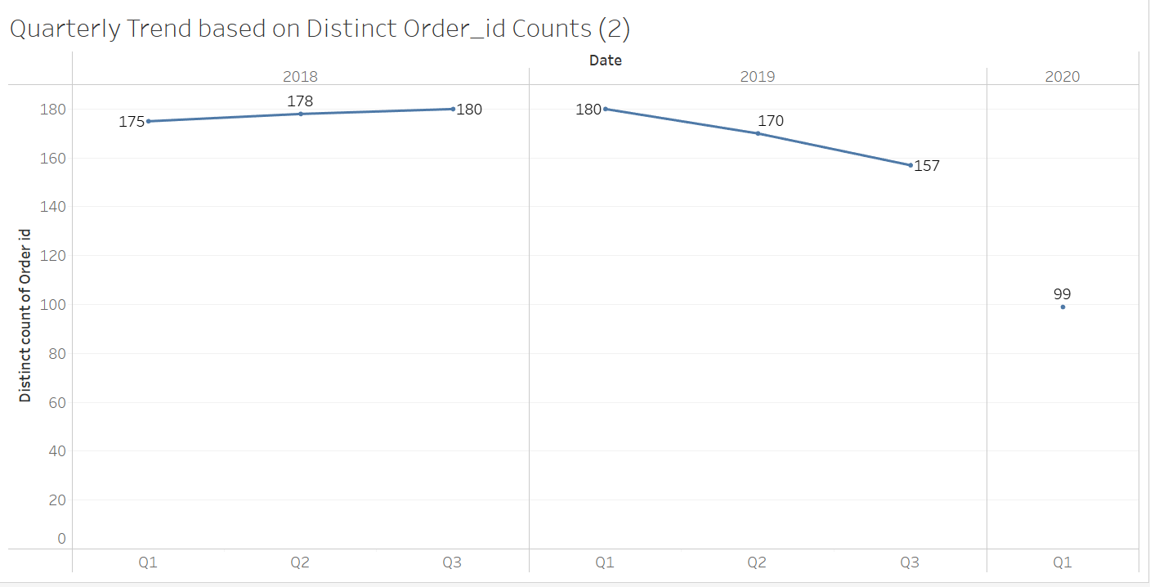
Quarterly Trends based on Number of Orders

Slide 10
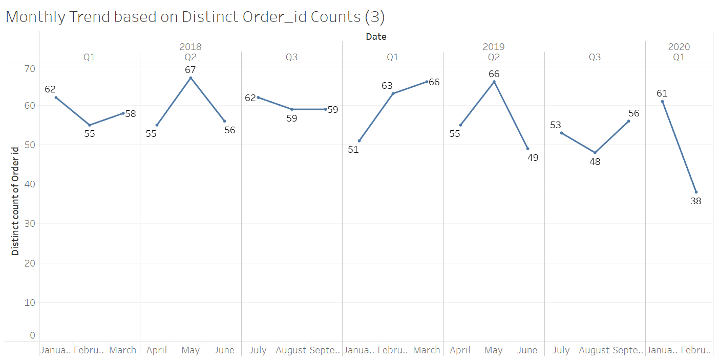
Monthly Trends based on Number of Orders

Slide 11
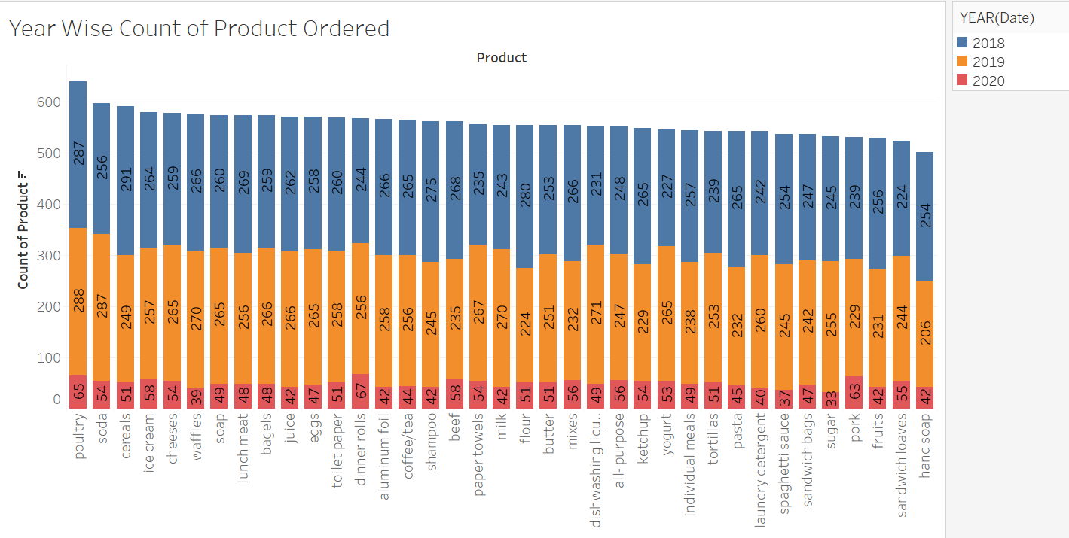
Visualizing Year Wise Count of Ordered Product

Slide 12
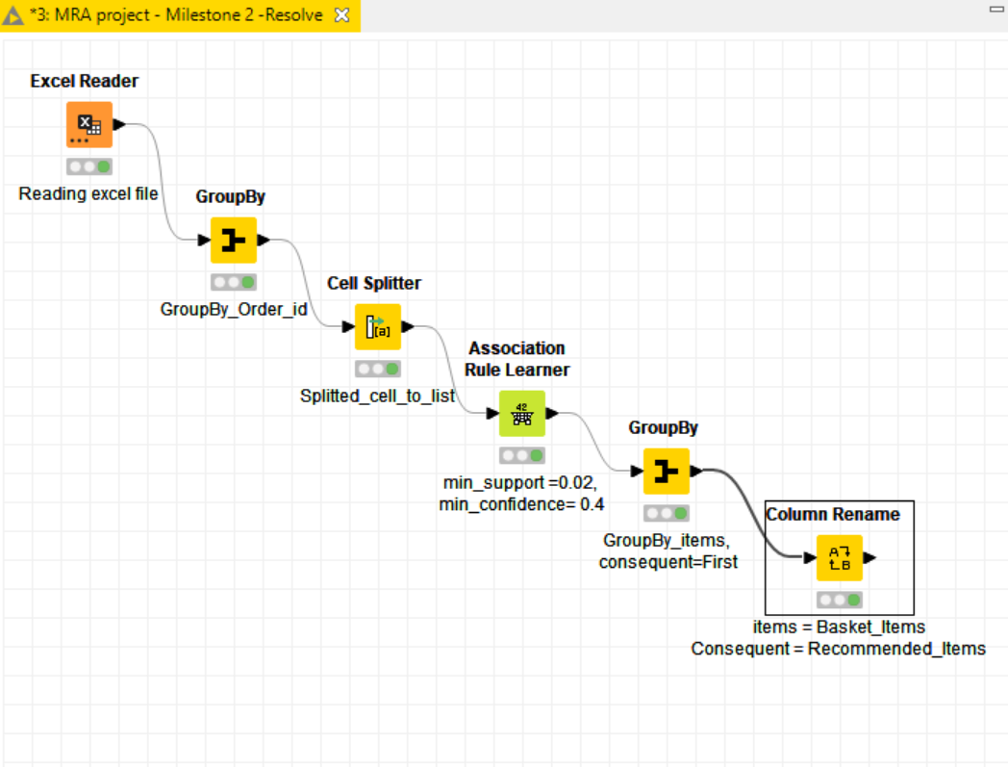
KNIME Workflow Image:
Steps:
Reading the dataset using Excel Reader.
Applying Group by on ‘Order_id’.
Splitting the cell to list using Cell Splitter node.
Applying the Association Rules using Association Rule Learner.
Again applying the Group by on Products(Items).
Renaming the item column to Basket_Items, and Consequent to Recommended_items.

Slide 13
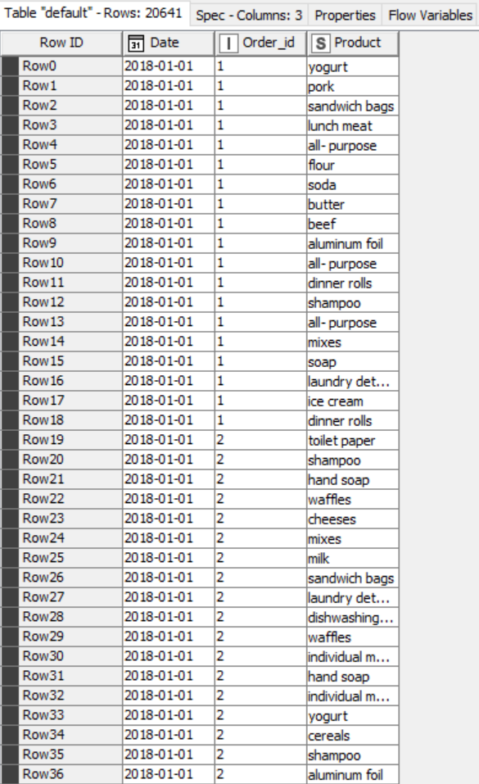
Sample Image of Original dataset (after reading excel in KNIME)
Displaying the sample image after reading the original dataset from the excel using Excel Reader.
Here we have columns : Date, Order_id, and Product.
Total Rows: 20641
Total Columns: 3
In the next step, we will apply group by on ‘Order_id’ and will do the concatenation on ‘Product’.

Slide 14
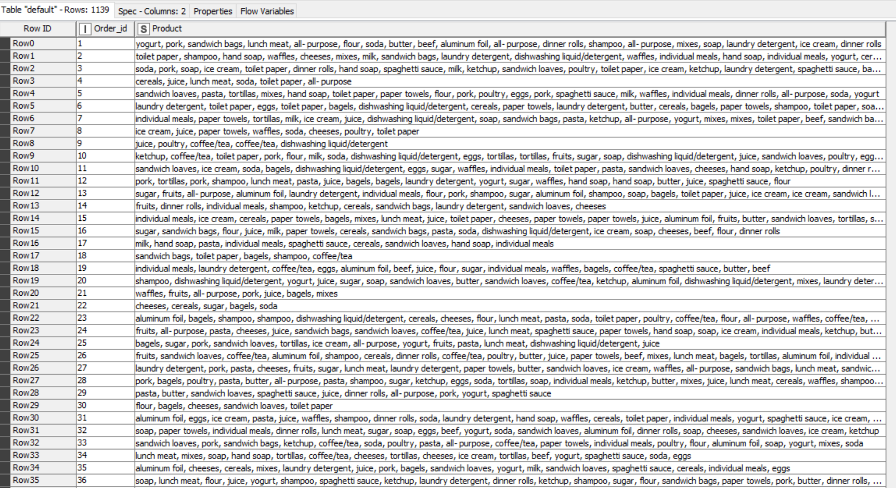
Sample image after applying the Group_by on ‘Order_id’ (KNIME)

Slide 15
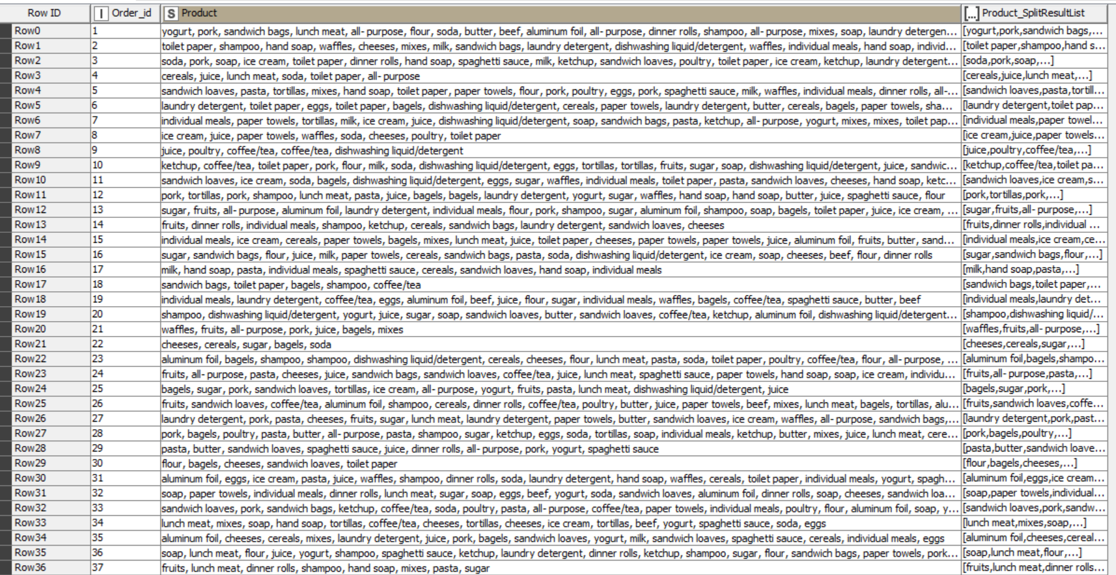
Sample Image after applying Cell Splitter

Slide 16
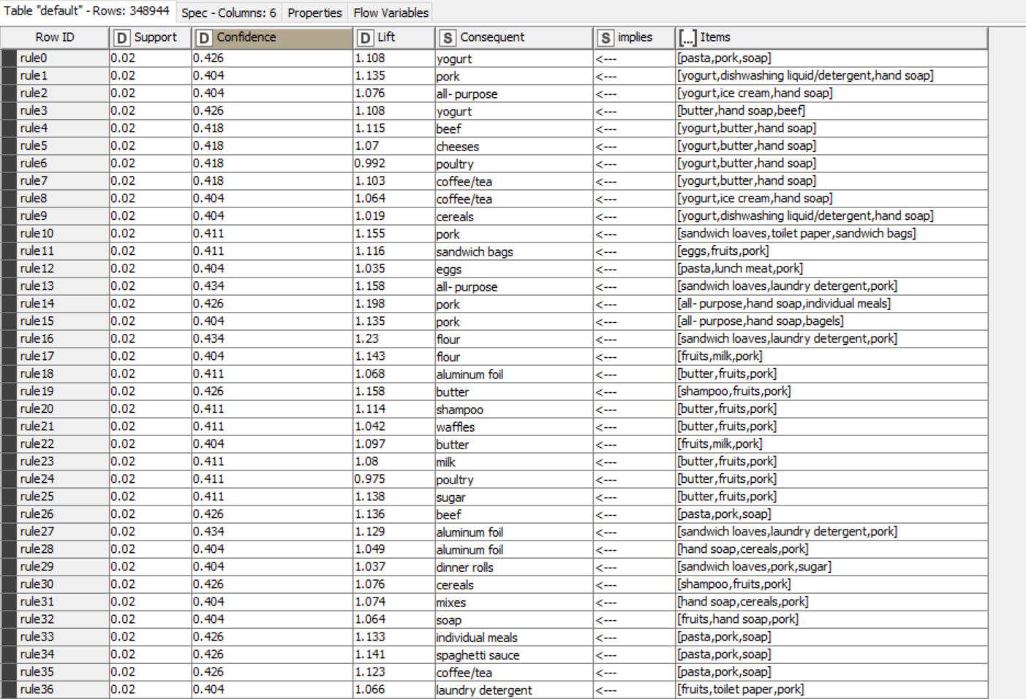
Sample Image after applying Association Rules : Support=0.02, Min confidence=0.4

Slide 17
Reason behind Association Rules
Since we need to get the best and enough association rules for our list of given products and recommended products on the basis of each individual orders, we should start with the minimum support and min confidence levels.
As it is an iterative process, I tried selecting minimum support at different levels like 0.05, 0.04, 0.03, 0.02 but got the best results and enough rules by using support at 0.02, so I chose 0.02 as the minimum support.
And same goes for minimum confidence, I chose 0.4 as the minimum confidence level.
The lift value is a measure of importance of a rule. The lift value of an association rule is the ratio of the confidence of the rule and the expected confidence of the rule.
There are different lift values for different combination of products in the basket.
A lift ratio larger than 1.0 implies that the relationship between the antecedent and the consequent is more significant than would be expected if the two sets were independent. The larger the lift ratio, the more significant the association.

Slide 18
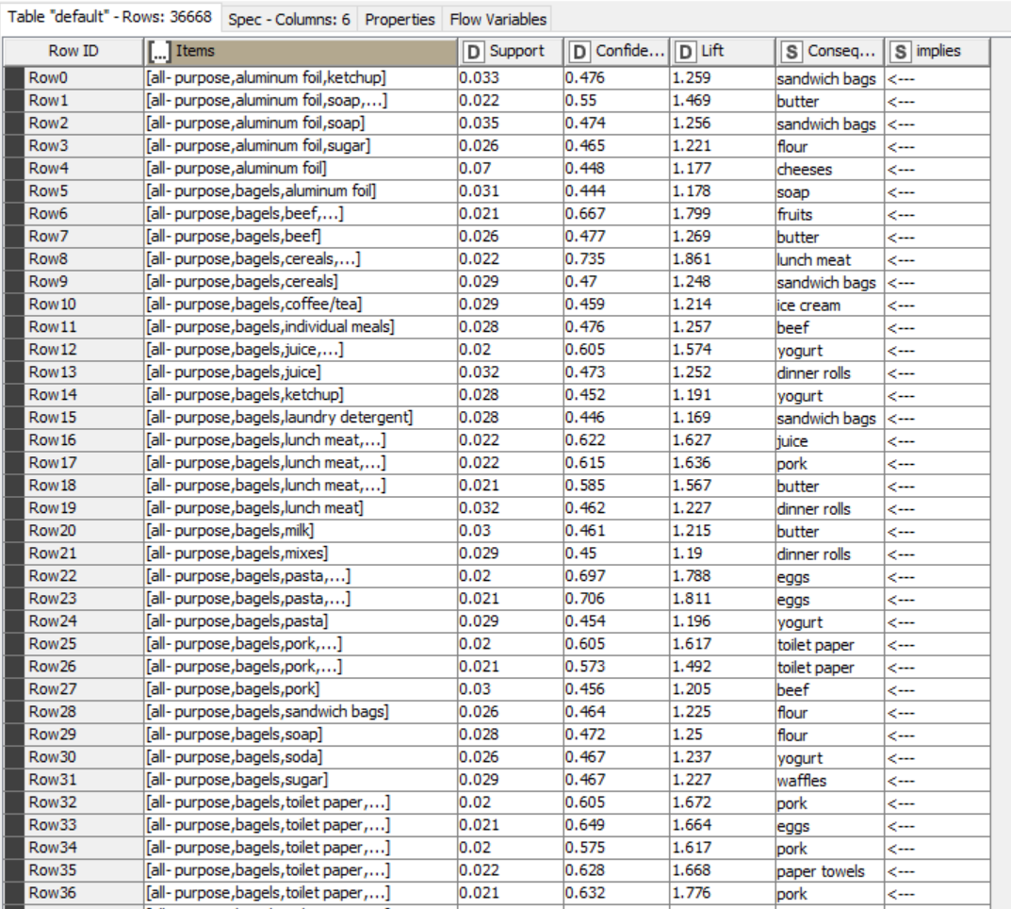
Sample image after applying Group_by on items, consequent = First

Slide 19
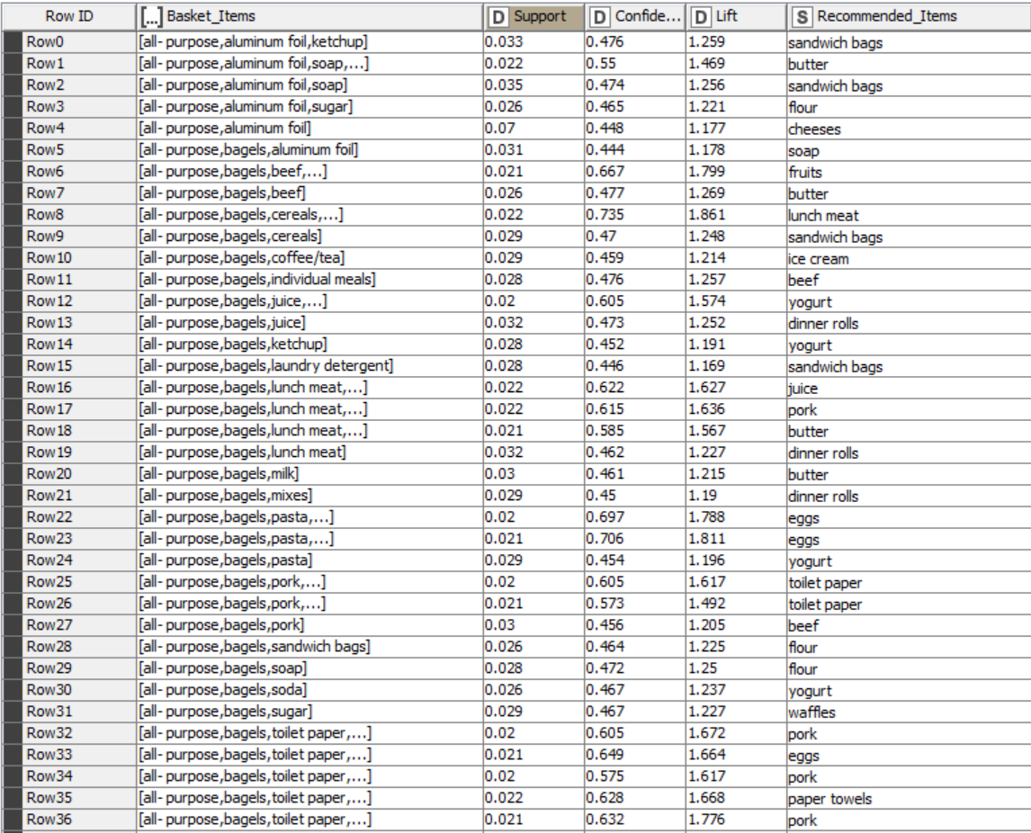
Sample Image after renaming column names

Slide 20
Suggestion of Possible Combos with Lucrative Offers
After applying the association rules, we can see in the final table that the customers who bought dinner rolls, cheese, fruits, also bought yogurt, aluminum foil, eggs, ice cream. So, in this category, we can make a food combo with some percent discount to get the customers all at once at some discounted price.
In the category of hand soap, shampoo, toilet paper, we could see people also added paper towels in their basket, so we can give a offer on a bundle of toilet paper and paper towels. We can also provide free hand soap with the big bottle of shampoo.
Customers who bought pork and eggs also bought beef, so in this food category we can give a discount based on some minimum quantity(in kilograms and grams).
With 0.021 support and at 0.649 confidence, we see that the people who bought ice cream, lunch meat, sugar together also added flour, beef and pasta in their basket. So we can make a ‘lunch items combo deal’ of these items all together and we can offer cheese or butter on some total minimum transaction amount.
We can also do a deal with online payment partners to provide cashback offers to our customers on particular payment method. In this way all will get some benefits.

